Slide 1



Home
Service
About Us
Contact
ENHANCING CUSTOMER INSIGHTS USING AI-DRIVEN INSIGHTS

Slide 2


INSTITUTE OF AERONAUTICAL ENGINEERING
Project tittle : AI-Powered Smart Shopping & Food Assistant
Team Members :
J. Gajanand - 23951A6649
S. Dharani - 23951A6645
B. Gayathri - 23951A65652

Slide 3


Studio Shodwe
Home
Service
About Us
Contact
PROBLEM STATEMENT
••AI-Powered Fashion & Food Recommendations
•Optimizing Shopping & Meal Planning with AI
•Shopping & food selection challenges:
•- Confusion in clothing sizes & appearance doubts
•- Lack of personalized recommendations
•- Difficulty in matching outfits & accessories
•- Struggles with healthy meal planning & dietary restrictions
•- Inefficiency in food ordering from multiple platforms

Slide 4

Studio Shodwe
Home
Service
About Us
Contact
EXPLORATORY DATA ANALYSIS (EDA)
Analyzed shopping & food preferences
Identified trends in user behavior
Missing value handling & data cleaning
Feature selection for AI-powered recommendations
01
02
03

Slide 5
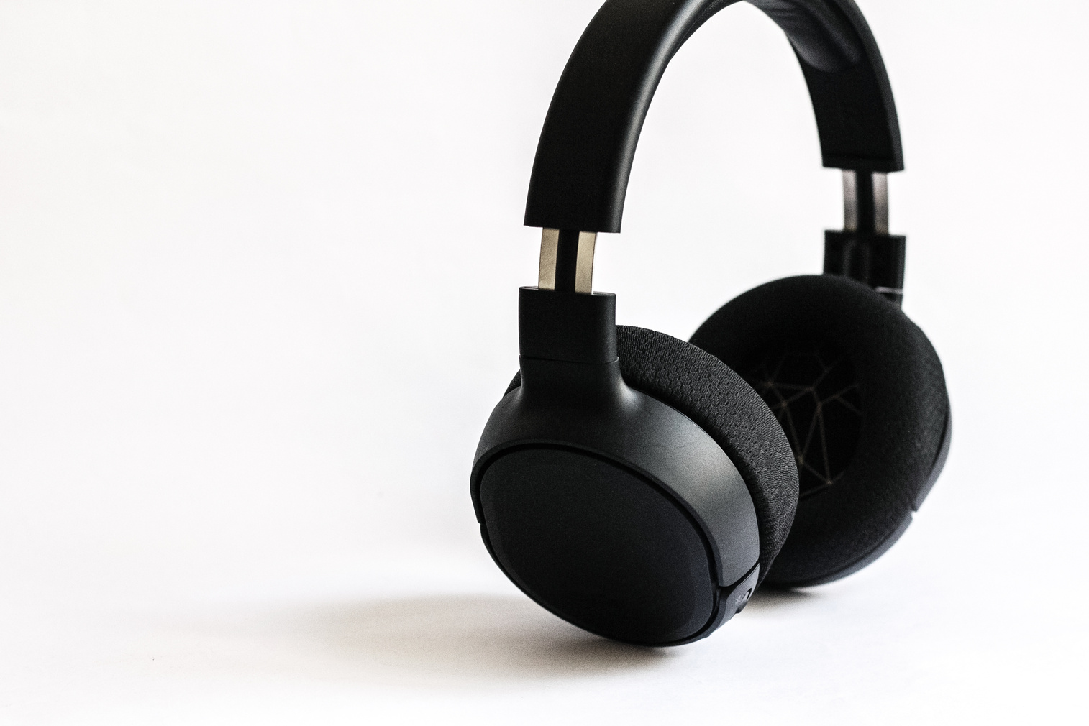


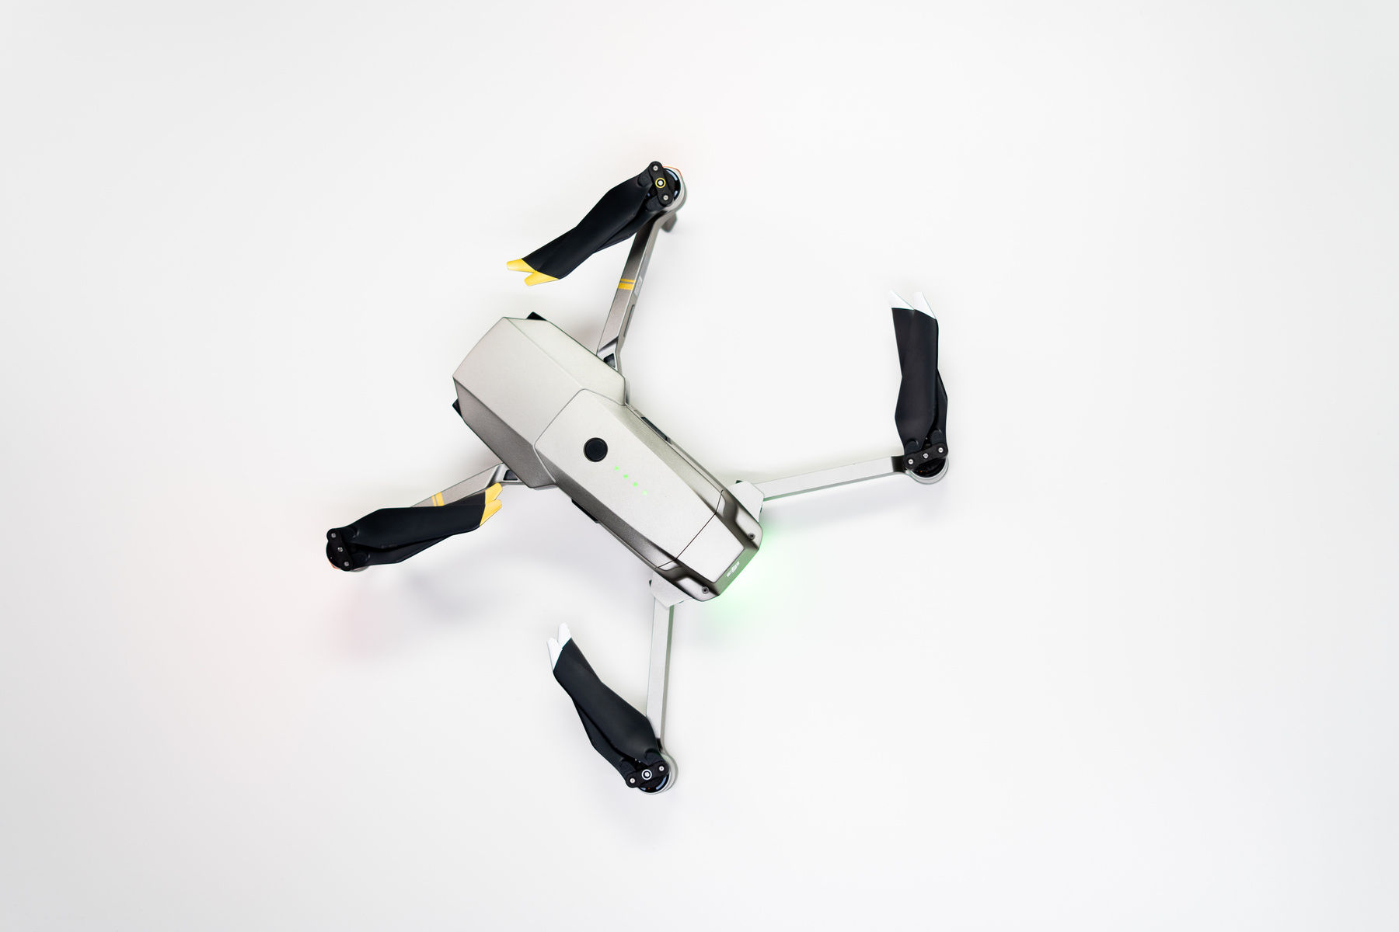
Studio Shodwe
Home
Service
About Us
Contact
PROPOSED AI-POWERED SOLUTION
•✅ Smart Clothing Recommendations (Body Type, Skin Tone, BMI)
•✅ AI Virtual Try-On (Face Swapping for Outfit Visualization)
•✅ AI-Powered Food Recommendations (Diet Goals, Allergies, Preferences)
•✅ Occasion-Based Outfit & Meal Matching
•✅ Automated Smart Ordering & Meal Planning

Slide 6

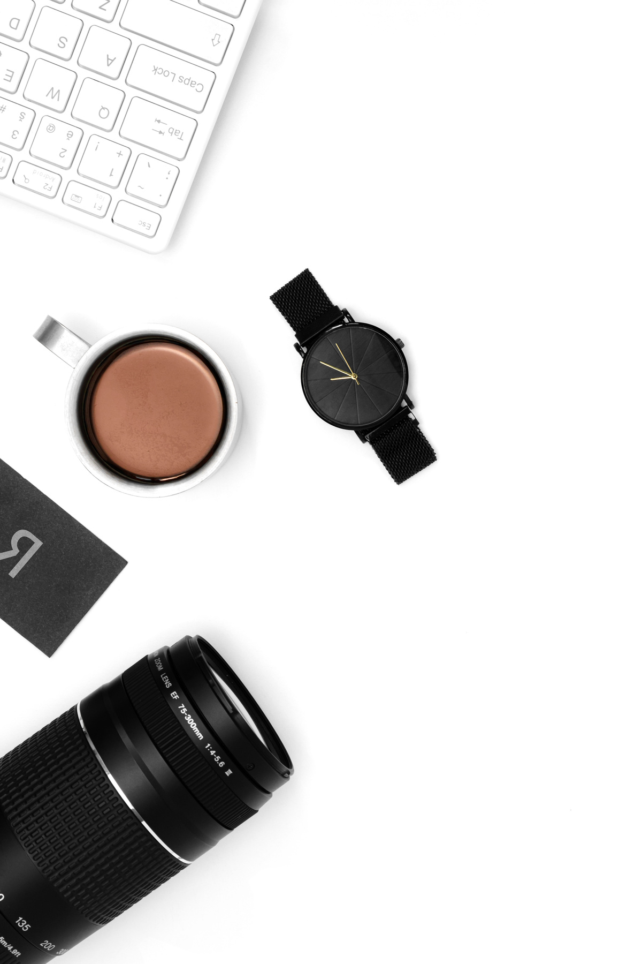
Studio Shodwe
Home
Service
About Us
Contact
KEY AI TECHNOLOGIES USED
•- Machine Learning (Personalized Recommendations)
•- Deep Learning (CNN, GANs for Virtual Try-On)
•- NLP (Customer Preferences & Context Analysis)
•- Computer Vision (Skin Tone & Body Type Detection)
•- API Integration (Myntra, Ajio, Zepto, Swiggy, Zomato)
01

Slide 7

Studio Shodwe
Home
Service
About Us
Contact
SOLUTION ARCHITECTURE & WORKFLOW
01
•- User inputs preferences or uploads an image
•- AI processes body type, skin tone & shopping patterns
•- Virtual Try-On & outfit recommendations generated
•- AI-driven meal planning based on health & taste
•- Smart ordering integrates with shopping & food platforms
02
03

Slide 8


Studio Shodwe
Home
Service
About Us
Contact
EXPECTED OUTCOMES & BENEFITS
🔹 Enhanced shopping & food experience
🔹 Faster decision-making for outfits & meals
🔹 Personalized recommendations improve user satisfaction
🔹 Cross-domain AI integration for fashion & food
🔹 Seamless e-commerce & food ordering automation

Slide 9

Studio Shodwe
Home
Service
About Us
Contact
CONCLUSION
•AI-powered insights enhance customer experience, making shopping & meal selection efficient, personalized, and seamless!

Slide 10
Studio Shodwe
Home
Service
About Us
Contact
THANK YOU

